Slide 1
Internship presentation
Kushagra Gupta

Slide 2
ABSTRACT
I carried out my internship at Climbax Entertainment Pvt. Ltd. Climbax aims to bridge the gap between the real and the virtual world by developing customized solutions in the field of virtual reality, 2D/ 3D animation, VFX, software, mobile app and Web development, films and media and digital marketing and it offers internship to the students who are in need of education about the same. Internship is an opportunity to relate what has been covered in the class and what is applicable in the practical life. The purpose of the program is to fulfill the core equipment for the award of Bachelor degree in technology to get a practical aspect of the theoretical work.
During my internship period, a number of approached and exposure methods were used which included: hands on, through reading relevant materials, and also questions and answers approach.
I was assigned to technical department. I gained knowledge of HTML, CSS, PHP and JavaScript
In conclusion, this was an opportunity to develop and enhance skills and competencies in my career field which I actually achieved.

Slide 3
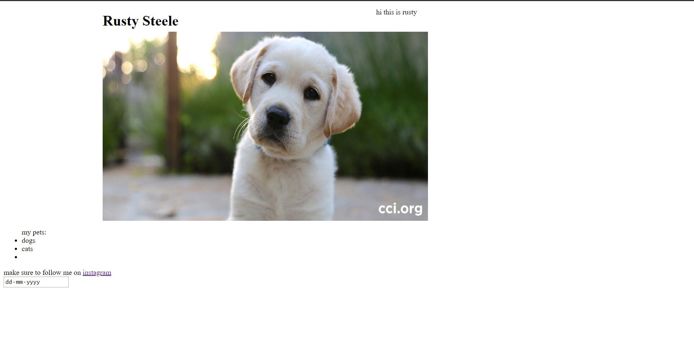
Week 1
Week 1
Started with HTML referring to MDN .
Designed my first webpage using just <h>, <ul>, <a>, <form>, <input> and <img> tags.

Slide 4

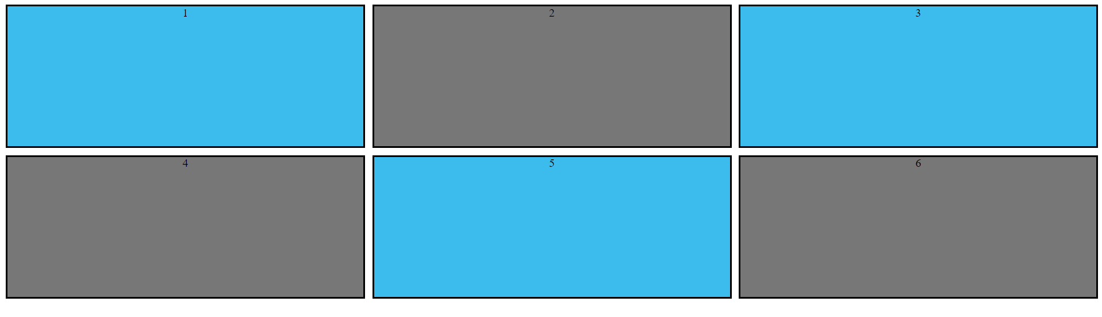
CSS Tutorials from MDN.
Designed a ‘tic-tac-toe’ using <table> tag using rowspan and colspan, styled it using CSS.
Designed a grid test layout and, explored and applied various properties of Grids on it

Slide 5
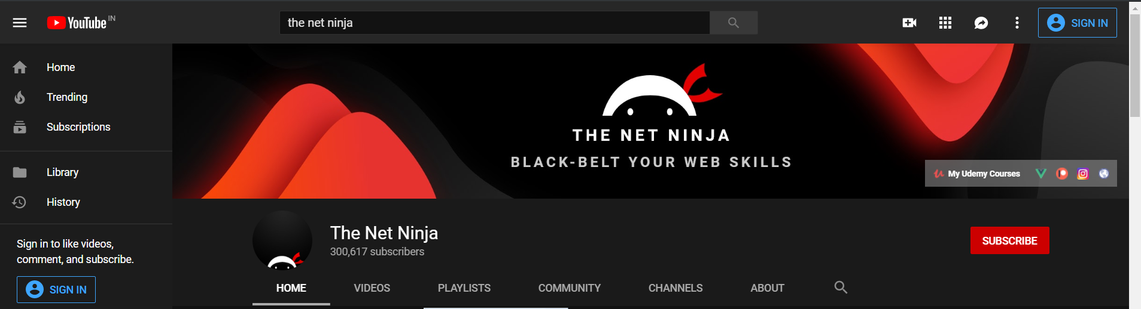
WEEK 2
Started with video tutorials from ‘The Net Ninja Channel’.
Covered topics: basic syntax, inline and embedding styles, targeting elements, selectors, box models, text formatting, styling links, adding backgrounds, CSS Positioning , Flexbox, and Grids.
Started ‘The Peaky Blinders’ project.

Slide 6
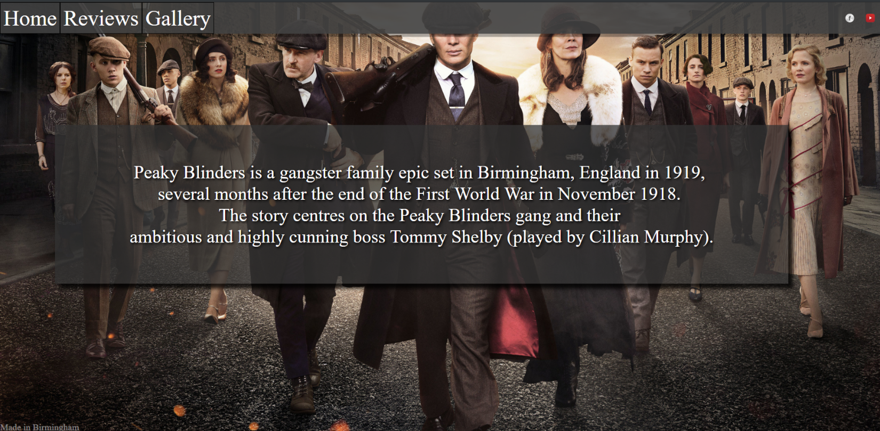
WEEk 3
Continued with ‘The Peaky Blinders ’project; styling Home and Reviews tab of the website.

Slide 7
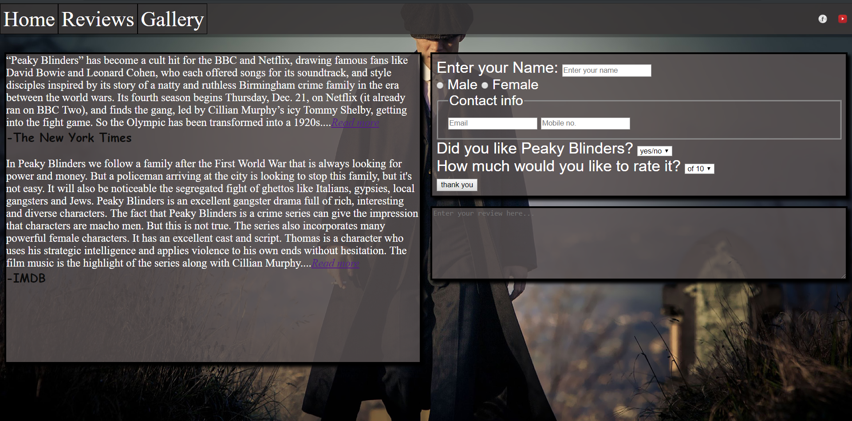
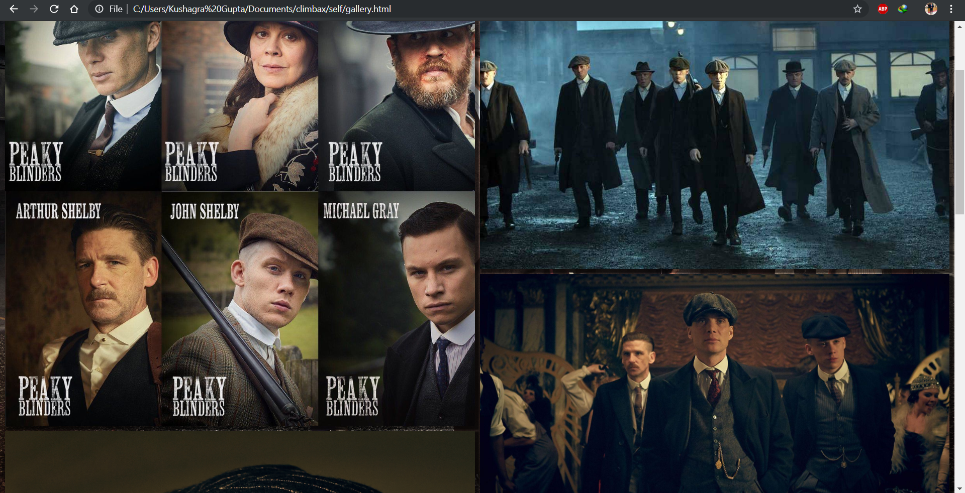
Used <form> and tags like <article> for formatting the reviews.
Added a ‘Gallery’ page to the website displaying some of the eye-catching images form the TV Series ‘Peaky Blinders’ using flexbox and finalized the project making it responsive.

Slide 8
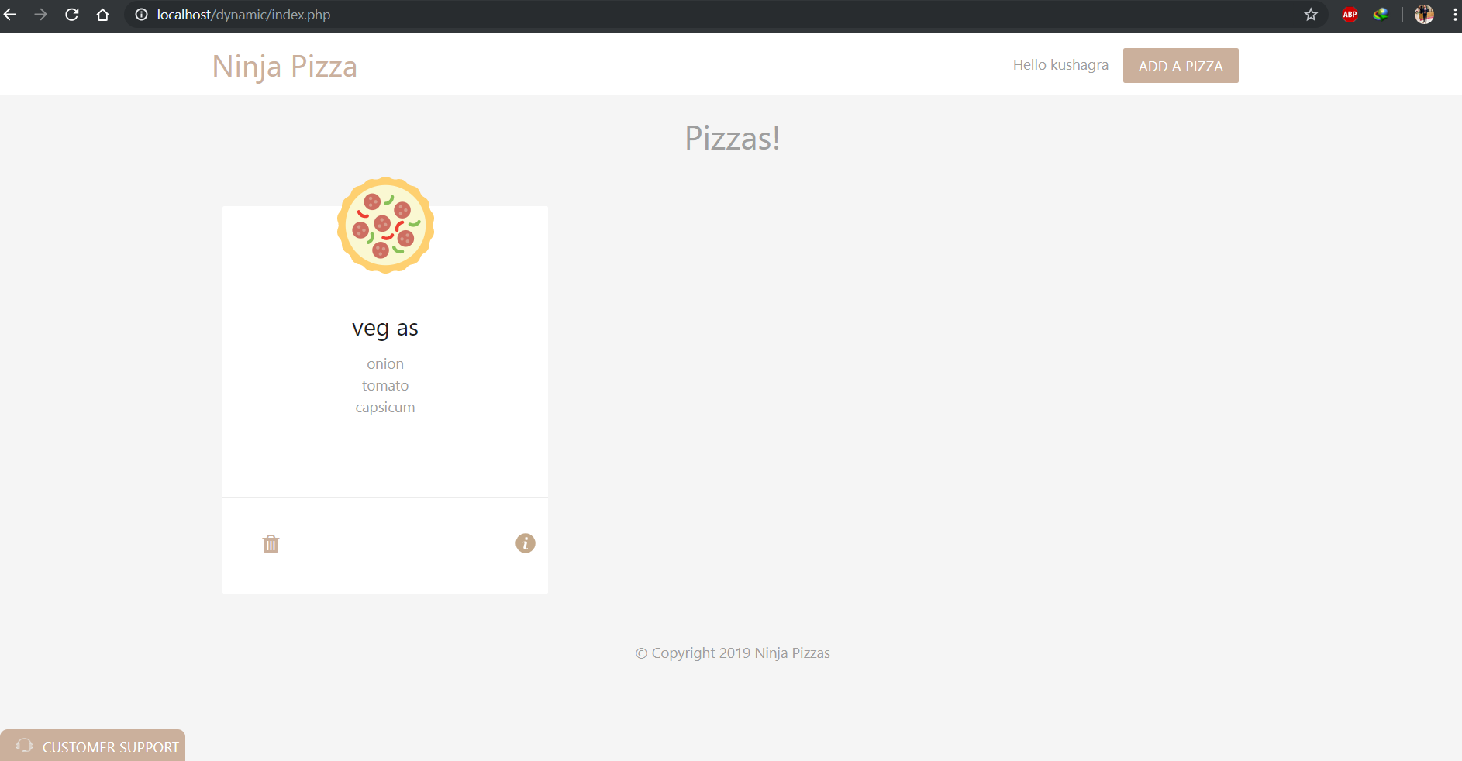
WEEK 4
Started with “ninja pizza” project along with video tutorials from ‘The Net Ninja’ learning PHP and MySQL Database Handling.
This project offers features like:
User Login and registration
Creating pizza according to ones’ entered ingredients
Also takes in their email address and checks for validity
Stores and displays pizzas separately of the users hiding them from one another using MySQL databases
Also offers customer support where if unsatisfied one can upload their respective bills and apply for refunds

Slide 9
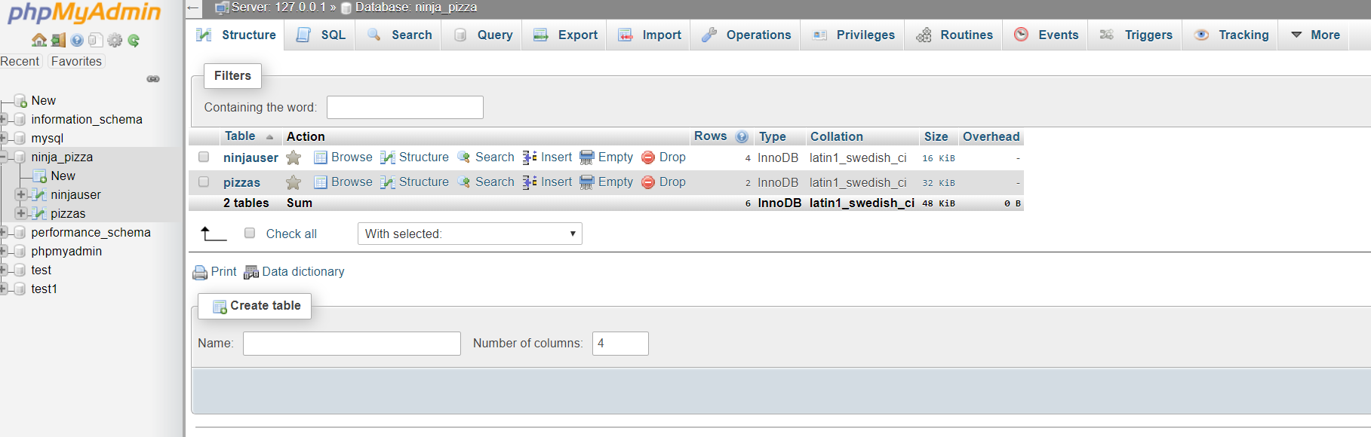
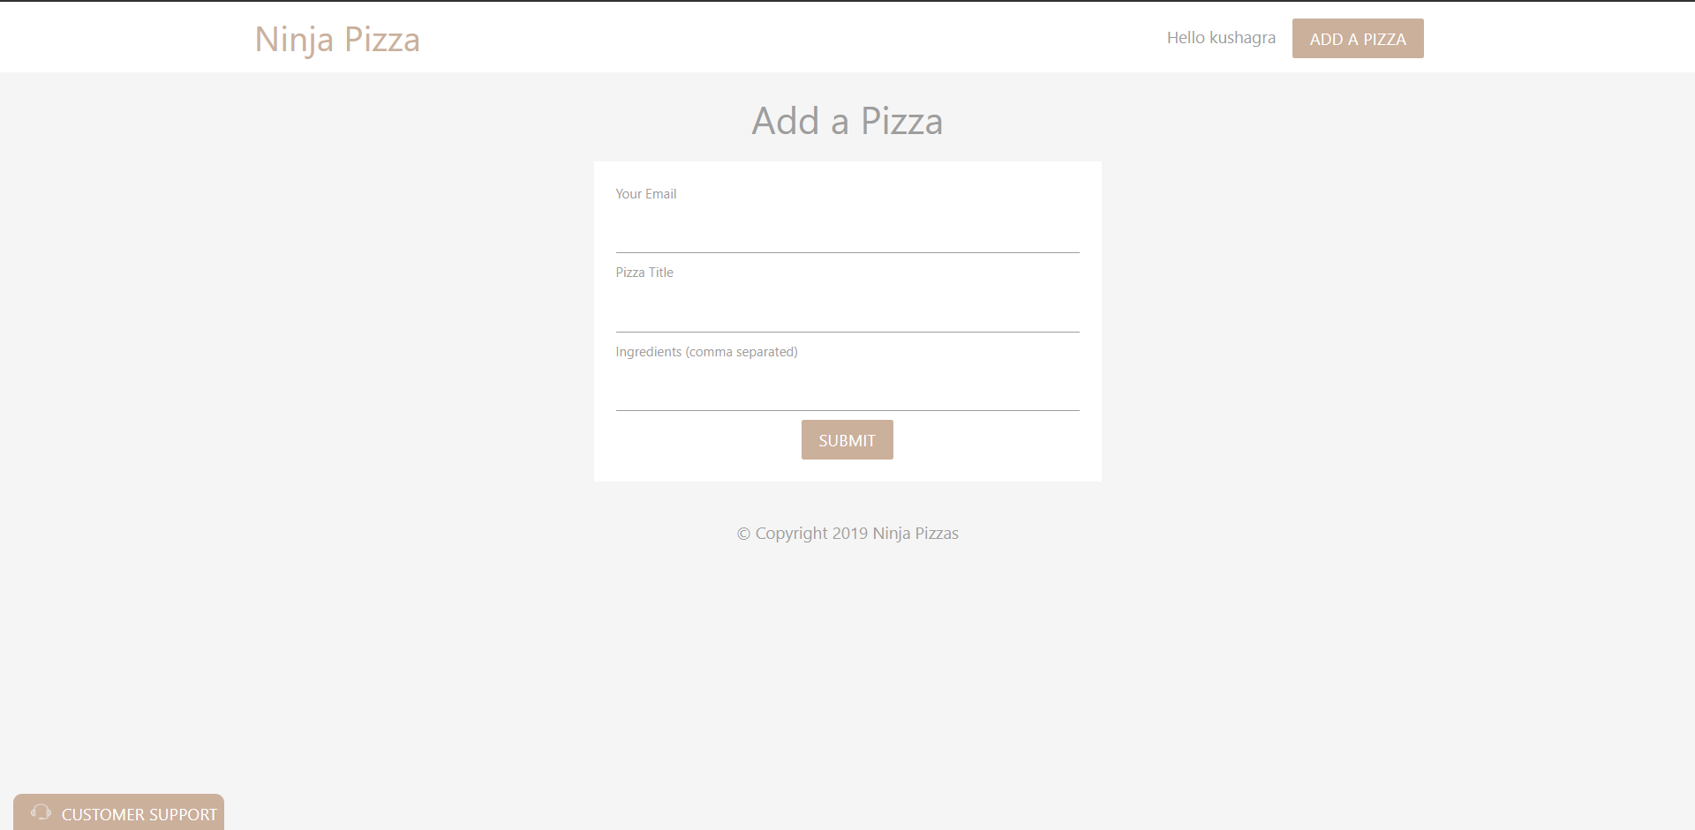

Slide 10
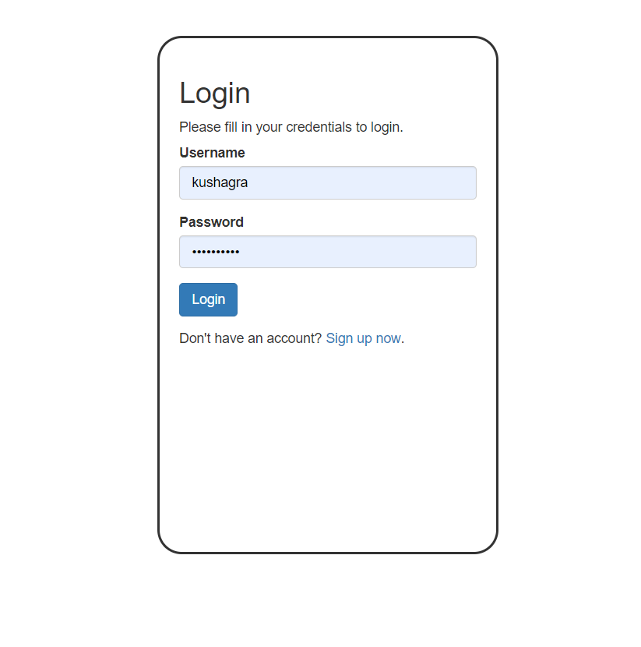
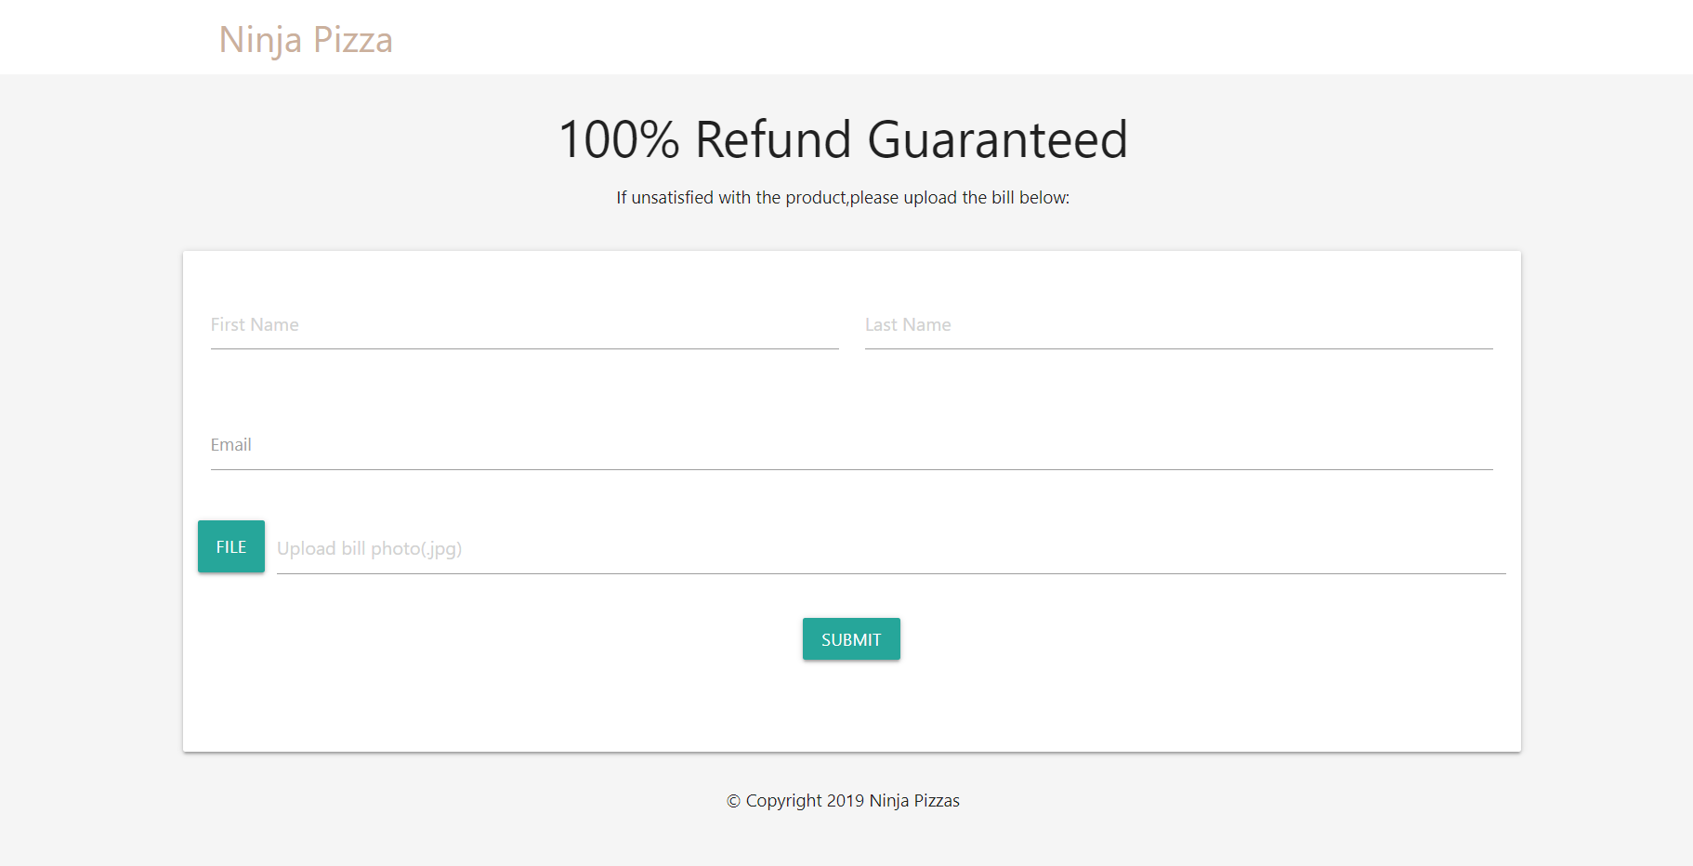
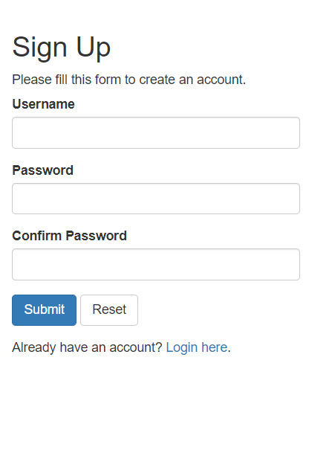

Slide 11
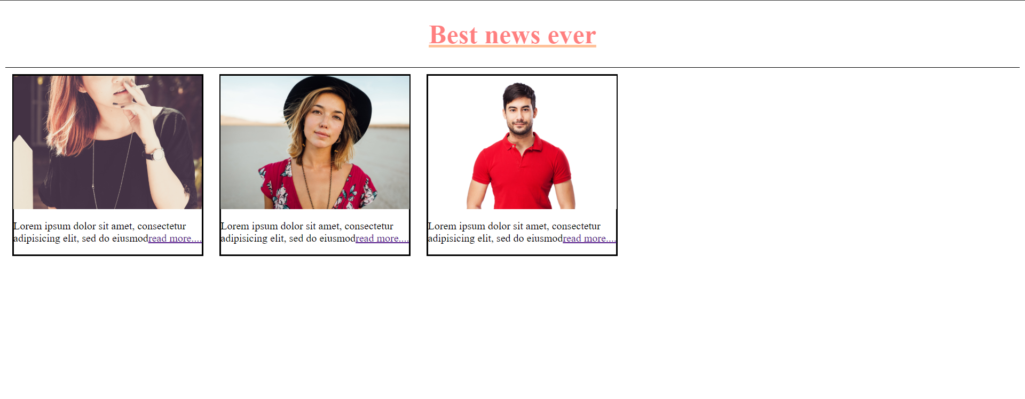
Started exploring WordPress and learnt installing various pre-built themes. Used a preformatted theme to design a news article site.

Slide 12
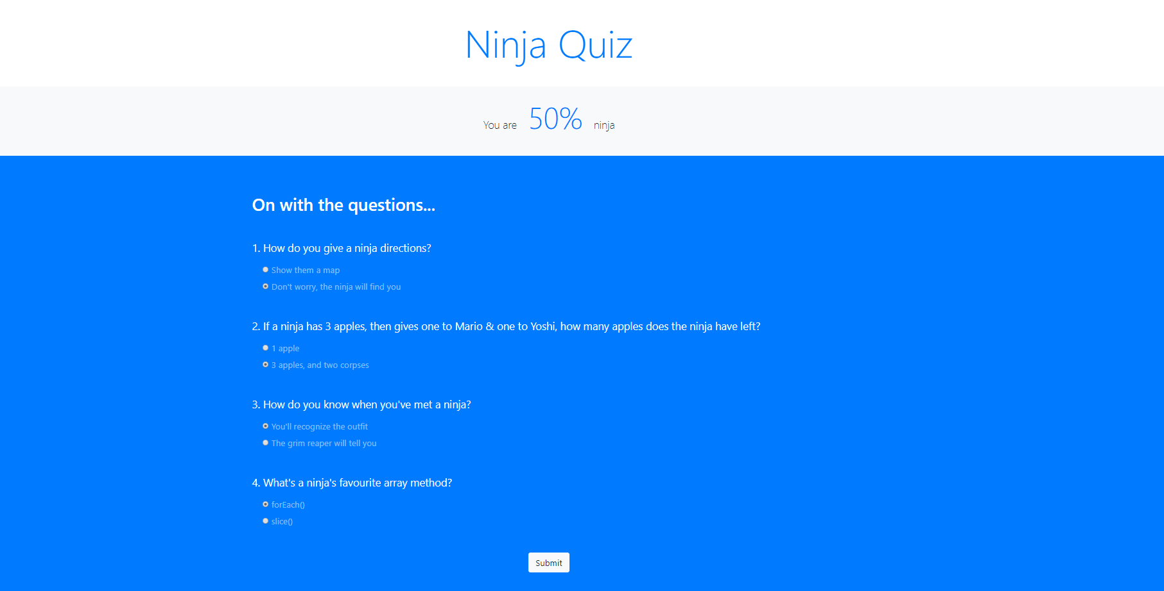
Week 5
Started with JavaScript from MDN and the Net Ninja JS for Beginners course
Designed a JS based quiz which calculates your score on the basis of your answers upon hitting ‘submit’ button. Also animated the display of the score. Also formatted it using Bootstrap 4.

Slide 13
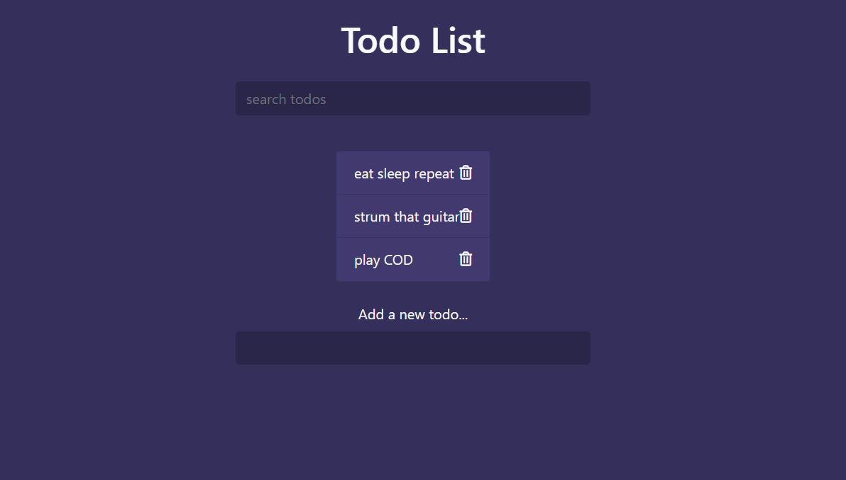
Designed a ‘To-Do list’ which offers addition and deletion of items and also allows to search events in the list. This ‘To-do list’ is built using JavaScript and has been formatted using bootstrap.

Slide 14
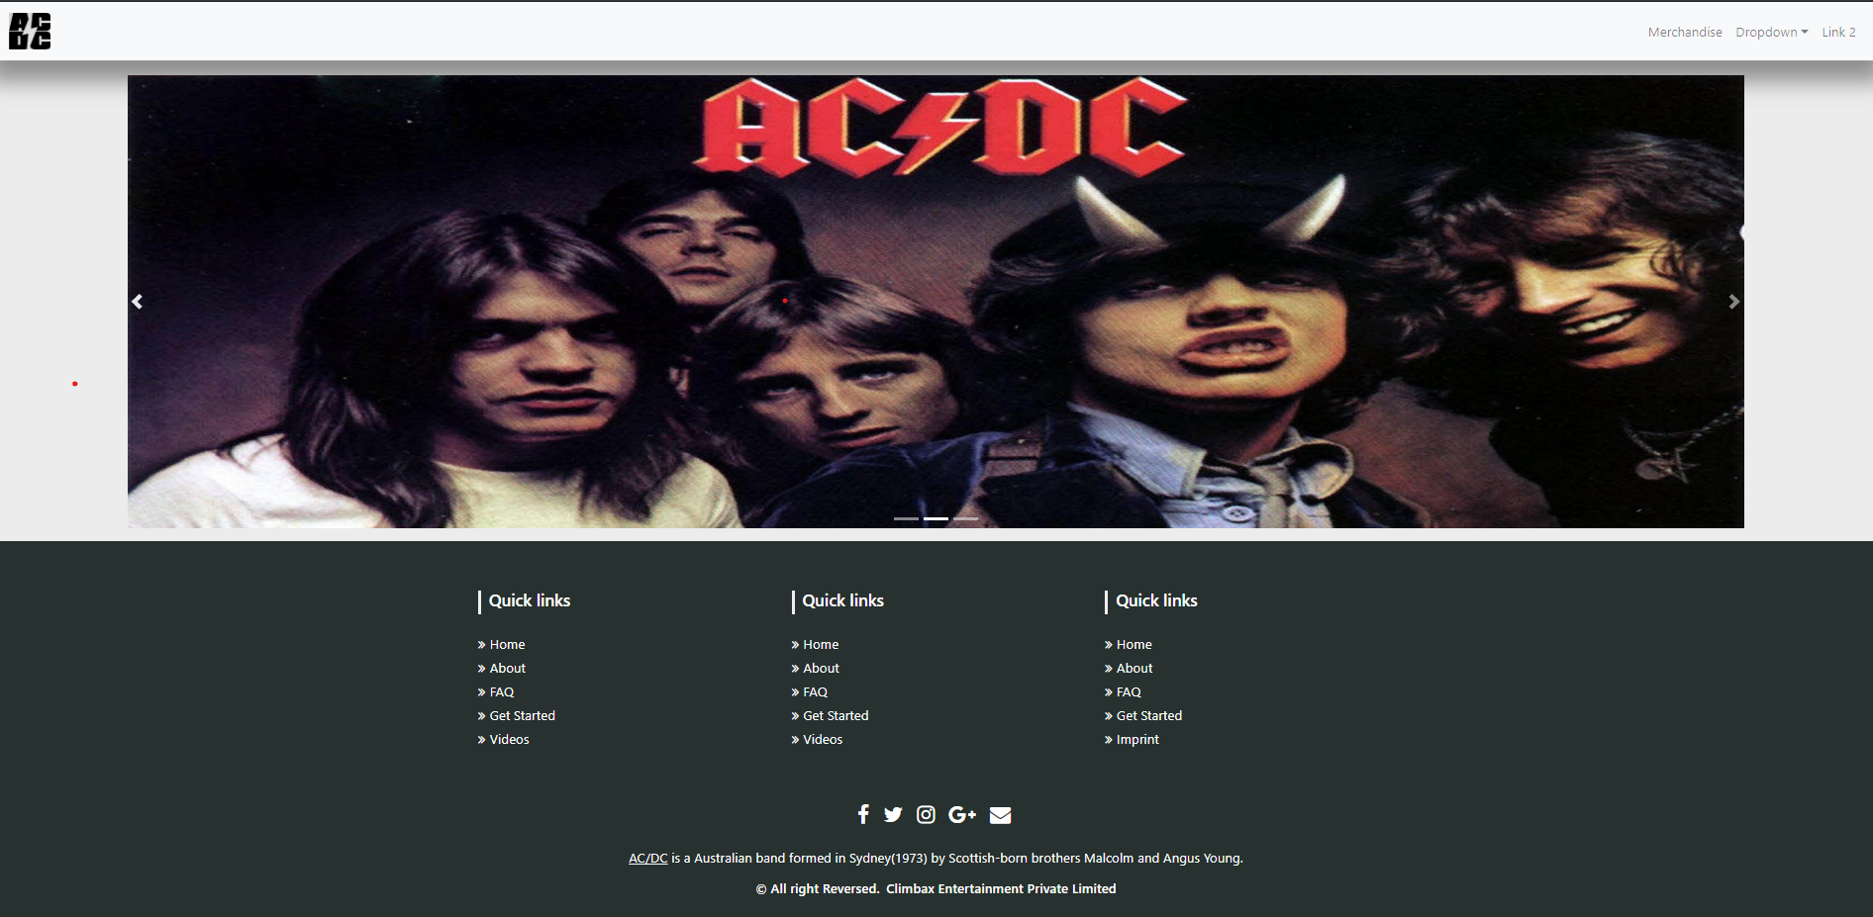
Week 6
Started with ASync part of JavaScript and covered fetching of JSON Data.
Also designed a website named ‘AC/DC’ which offers merchandise of the band. You can also filter the items based on categories like Male/Female. It involves application of HTML, CSS, Bootstrap, PHP and JavaScript.

Slide 15
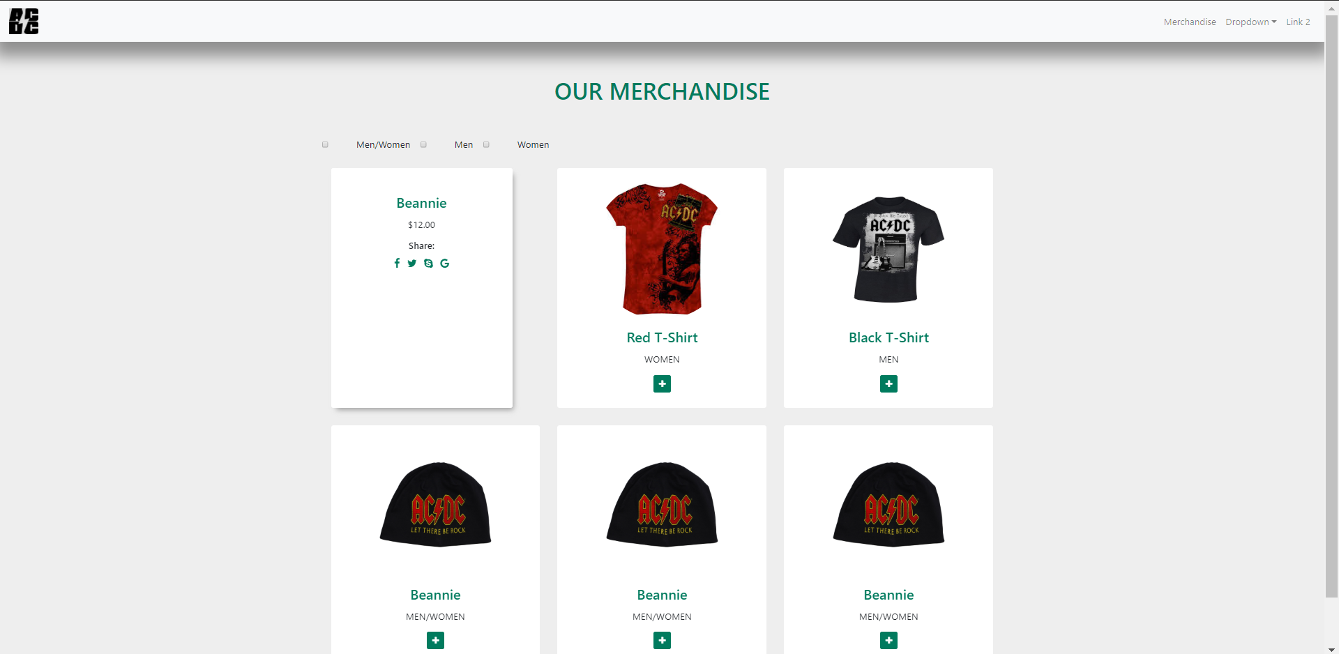
All of the items have been arranged onto cards which rotate when hovered upon.
One can also filter them according to men and women categories.

Slide 16
Conclusion
With the objective of starting with Web Development, I joined Climbax Entertainment Private Limited’ s internship programme to help instil interest for the field in me and to my amazement I have been able to do that. I have learnt HTML, CSS, Bootstrap, PHP and JavaScript. Variation of technologies and frameworks in this field have helped me keep a keen eye towards this field till now and I am sure will adhere to the roadmap to a ‘Full Stack Web Developer’.
I plan to advance and grill myself in JavaScript followed by learning some of the JS libraries like jQuery, Angular and React, and would love to keep working in this field.

